Slide 1
Role of the CIO in the New IT Landscape
24/9/2013 CIO Summit Asia
Notes:
Synopsis:
Technology is playing an ever-evolving role in business operations nowadays. The pace and the scope of changes taking place in technology today are changing the foundation of IT and businesses. Mr. Mok will look at the change of role of CIOs in businesses, how they are expected to create business strategies, drive transformation and take risks. He will also explore how the adoption of cloud computing and big data is pushing enterprises to rethink their data infrastructure, changing their work processes and informing business decisions.
3 key takeaways:
Enterprises must innovate meet the sophisticated demands for security, flexibility and collaboration
CIOs are expected to collaborate, innovate and lead at the top level
CIOs understanding of technology will help enterprise do more with less and adapt

Slide 2
Survey by HBR & the economist (2012)
Almost half of CEOs feel IT should be a commodity service purchased as needed
Almost half of CEOs rate their CIOs negatively in terms of understanding the business and applying IT in new ways
‘be more strategic’??
Notes:
HBR, Economist and CEB, Intel, TNS global – survey findings
Key findings from research:
Almost half of CEOs feel IT should be a commodity service purchased as needed
Almost half of CEOs rate their CIOs negatively in terms of understanding the business and understanding how to apply IT in new ways to the business
57% of the executives expect their IT function to change significantly over the next three years, and 12% predict a “complete overhaul” of IT
Only a quarter of executives felt their CIO was performing above his or her peers

Slide 3

How relevant are today’s CIO’s?
Do CIOs have a say in the board room when crucial business decisions are made?
Constant flux in the corporate IT landscape
      Frequent corporate re-organizations and mergers
      Rapid change in technology
Role of the CIO
      Changing expectations and
      required skills
      Communications/leadership traits
Empowering new generation CIOs
      How to stay ahead of it all?
Notes:
How CIO go on massive transformation and metamorphosis
Key proposition: IT is more important than ever in our increasingly digital economy where digital technologies are having an impact in just about every single aspect of the business. In response, the role of the CIO is evolving in multiple directions.

Slide 4
Evolving landscape of corporate it

Slide 5
Things were simpler back then
Focus on system development with long development cycles
Installation and management of solutions and services
Outsourcing: vendor management
Tougher IT challenges and rapid changes today
Adapt, Change, Innovate
Notes:
What CIOs looked like back then before everything began to change

Slide 6
Nature of business is changing…
Changing priorities, compliance needs
More collaboration and shared services
Reliance on behavioral science and data analytics
Under changing management mindset and inevitable resource limitations.

Slide 7
...Reflected in the change of it landscape
Outsourcing and re-engineering
Security and Compliance
Empowered consumers and users
Socially embedded and enabled
Notes:
CIOs need to do all the OLD things, but bunches of new things are thrown at them
- Visionary on business need, ambassador for new tech acquisition, plus manager, plus gatekeeper to keep things working

Slide 8
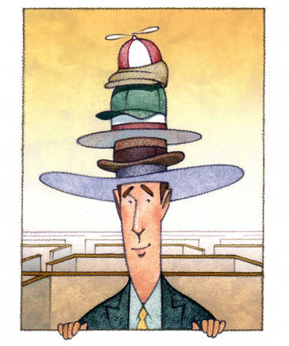
The many hats that a cio wears
Strategist
Implementer & problem-solver (operation)
Agent for innovation
Risk manager
Data analyst
Transformation leader
Business Process “Re-engineer”
Chief Privacy & Security Officer, too

Slide 9
The ultimate multi-tasker?
Vision and business strategy
Holding things together
Keep things running
How do you allocate your time and attention?
Notes:
Keep things going
IT Operations management
Risk management, security and compliance
Holding it all together
Outsourcing management
System integration
Bringing vision
Business strategy
Talent management

Slide 10
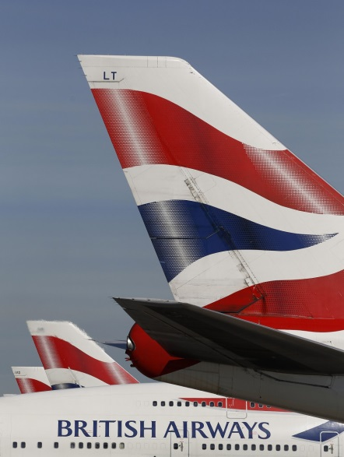
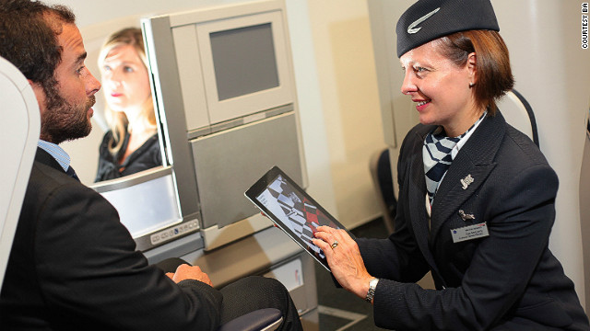
Sensitive area - Privacy
British Airways – Know Me Programme
Goal: Data optimisation for targeted marketing
Equipping crew with iPads to access info of first-class travelers; ability to search Google images for specific customers
The good: More personal touch and service for high profile travelers
The bad: Invading privacy? Too intrusive?
Notes:
Example: Company change operation processes by big data analysis
e.g. delay or problems in previous flights so crew can apologise

Slide 11

information security and compliance
Mobile device security
Data storage privacy
Cloud security
Cyber-threats (Crime, Hacktivism, Espionage, War)
Human factor (carelessness and risky behavior)
Notes:
Understanding how to secure company information while complying with laws and regulations is essential in light of a rapidly expanding IT landscape,
from mobile device security to data storage and privacy to cloud computing security to the sometimes-fuzzy parameters of the digital workplace.

Slide 12
Expectations on today’s cio’s

Slide 13

Master juggler that can
Do MORE with LESS
Innovation
Infrastructure
Integration
intelligence
Cost
Scalability & efficiency
Stability and security
Value generation

Slide 14
Strategic vision: aligning technology change with business goals
%
Source: Forrester survey, 2012
Notes:
Forrester survey of more than 100 executives involved in business transformation in the past 3 years found that 53 percent of respondents stated that the CIO (29 percent) was the most senior leader in driving or supporting a business transformation. The CEO was tied for second place (24 percent) with the CTO.

Slide 15

Collaborate and communicate at all levels
Influencing and engaging:
Board of directors
Fellow C-level executives
Internal users and IT staff
Vendors and partners
Customers and end-users
Notes:
The step-up: be good with people (talent management)

Slide 16

Innovate: finding and creating the…
Notes:
3D printing?
Internet of things?
Super fast internet connection?

Slide 17
next gen cio’s must
Know and talk business, not just tech
Influence your peers in C-suite and stakeholders
Accelerate innovation
Be ready to disagree and ‘drive’ business

Slide 18
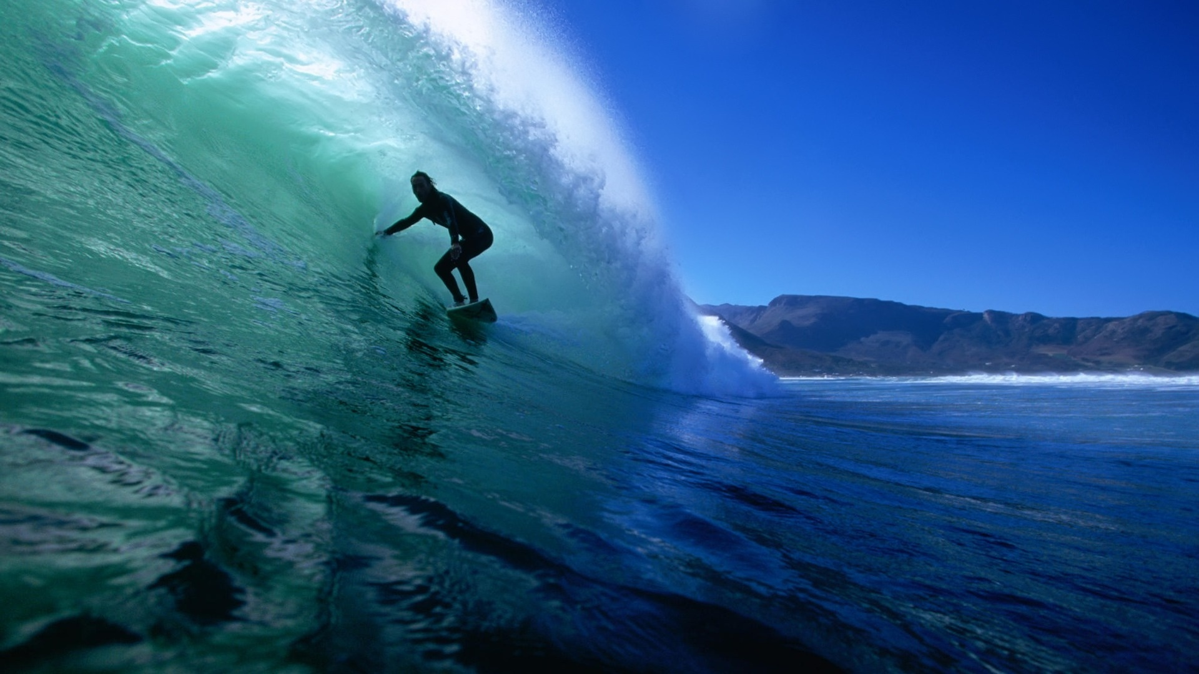
A CIO is like a good surfer that knows the waves, ride the waves with agility and skill, and always look ahead,
and still look great!

Slide 19
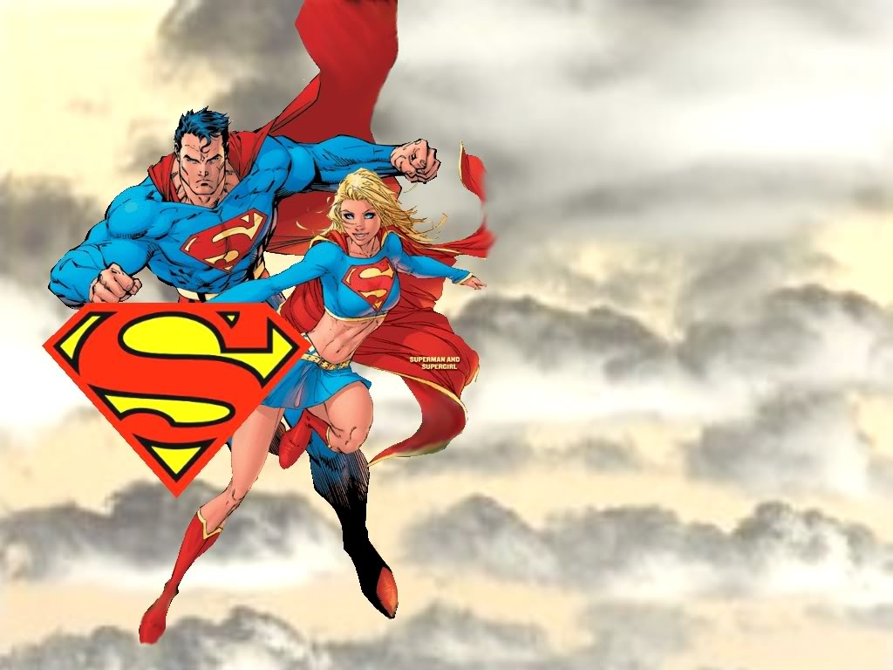
Tomorrow’s CIOs:
Looking for
Superman and
Superwoman!
A CIO is like a good surfer that knows the waves, ride the waves with agility and skill, and always look ahead,
and still look great!

Slide 20
Thank you!
Charles Mok
Legislative Councillor (Information Technology)
www.charlesmok.hk
charles@charlesmok.hk
Facebook: Charles Mok B
Twitter: @charlesmok

